Slide 1
Lecture # 7

Slide 2
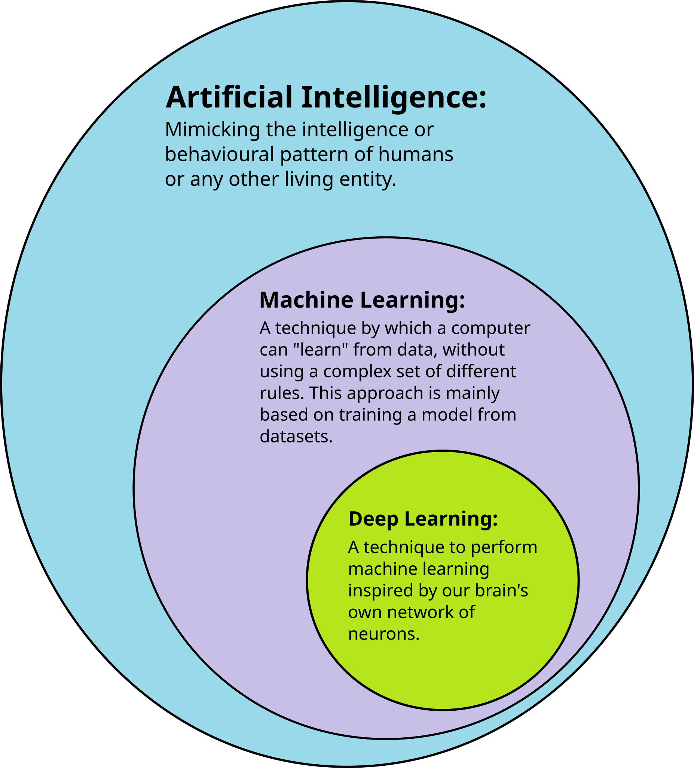
Introduction to Machine Learning

Slide 3

Introduction to Machine Learning
• Machine Learning (ML) is a field of Artificial Intelligence that enables computers to learn from data without being explicitly programmed.
• Instead of writing rules, the system finds patterns from data and makes decisions.
• The more data it learns from, the better its performance becomes.

Slide 4
What is Machine Learning?
Simple Definition:
• Machine Learning is teaching computers to learn from data
• Instead of programming every rule, we let the computer find patterns
Think of it like this:
• Traditional: You teach a child every single rule
• ML: You show examples and let them figure out the pattern
Example:
• Show 1000 cat photos → Computer learns what a cat looks like
[Visual Suggestion: Diagram: Traditional programming vs ML (side by side)]

Slide 5
Why do we need Machine Learning?
Problems too complex for traditional programming:
1. Pattern Recognition
• Recognizing faces in photos
• Understanding speech
2. Too Many Rules
• Email spam: Rules change constantly
• Stock market: Millions of factors
3. Personalization
• Netflix recommendations
• YouTube video suggestions
4. Automation
• Self-driving cars
• Medical diagnosis assistance
[Visual Suggestion: Icons: Face recognition, email, recommendation, car]

Slide 6
Traditional Programming vs Machine Learning
Traditional Programming:
Input + Rules → Output
Example:
• Input: Number
• Rule: If number > 0, output 'Positive'
• Output: 'Positive' or 'Negative'
Limitations:
• Need to write all rules
• Can't handle complex patterns
• Hard to update
Machine Learning:
Input + Output → Rules
Example:
• Input: 1000 cat photos
• Output: Labels (cat/not cat)
• ML finds the rules automatically
Advantages:
• Learns from examples
• Handles complex patterns
• Improves with more data

Slide 7
Types of Machine Learning
Three main categories:
1. Supervised Learning
• Learning with labeled examples
• Like learning with answer key
2. Unsupervised Learning
• Finding patterns in unlabeled data
• Like exploring without a map
3. Reinforcement Learning
• Learning through trial and error
• Like learning to ride a bike
[Visual Suggestion: Three icons/boxes representing each type]

Slide 8
Supervised Learning
Definition:
• We provide labeled training data
• Model learns the relationship
• Then predicts on new data
Examples:
• Email: Spam (1) or Not Spam (0)
• Images: Cat, Dog, or Bird
• Grades: Predict student performance
Two types:
• Classification: Categories (spam/not spam)
• Regression: Numbers (house price, temperature)
[Visual Suggestion: Diagram: Labeled data → Model → Prediction]

Slide 9
Unsupervised Learning
Definition:
• No labels provided
• Find hidden patterns in data
• Discover structure
Examples:
• Customer segmentation
→ Group similar customers
• Anomaly detection
→ Find unusual transactions
• Image compression
→ Reduce file size while keeping quality
Common techniques:
• Clustering: Group similar items
• Dimensionality reduction: Simplify data
[Visual Suggestion: Diagram: Unlabeled data → Patterns → Groups]

Slide 10
Reinforcement Learning
Definition:
• Agent learns by interacting with environment
• Gets rewards for good actions
• Gets penalties for bad actions
Real-world examples:
• Game playing (Chess, Go)
→ Learn winning strategies
• Robot navigation
→ Learn to avoid obstacles
• Recommendation systems
→ Learn what users like
Key concept:
• Trial and error with feedback
[Visual Suggestion: Diagram: Agent → Action → Environment → Reward]

Slide 11
Real-world Example: Email Spam Detection
Problem:
• Millions of emails daily
• Spam changes constantly
• Can't write rules for everything
ML Solution:
• Train on thousands of emails
• Learn patterns:
- Words like 'FREE', 'WIN', 'URGENT'
- Suspicious sender addresses
- Unusual formatting
• Classify new emails automatically
Result:
• Gmail filters 99.9% of spam automatically
[Visual Suggestion: Icons: Email inbox, spam folder, checkmark]

Slide 12
Real-world Example: Face Recognition
Problem:
• Identify people in photos
• Used in:
- Phone unlock
- Security systems
- Social media tagging
ML Solution:
• Train on millions of face images
• Learn facial features:
- Eye shape, nose, mouth position
- Face structure patterns
• Recognize faces in new photos
How it works:
• Extract facial features
• Compare with known faces
• Match if similar enough
[Visual Suggestion: Diagram: Face → Features → Comparison → Match]

Slide 13
Real-world Example: Recommendation Systems
Netflix & YouTube:
• Problem: Too many videos to choose from
• Solution: Recommend what you might like
How it works:
• Track what you watch
• Find users with similar tastes
• Recommend what they liked
Example:
• You watched: Action movies
• Similar users also watched: Sci-fi
• Recommendation: Try 'Interstellar'
Result:
• 80% of Netflix views come from recommendations
[Visual Suggestion: Diagram: User preferences → Similar users → Recommendations]

Slide 14
Machine Learning Workflow
Step-by-step process:
1. Data Collection
• Gather examples (photos, text, numbers)
2. Data Preprocessing
• Clean and organize data
• Remove errors and duplicates
3. Feature Extraction
• Convert raw data into features
• (We'll learn this in Part 2!)
4. Model Training
• Teach the model using data
5. Evaluation
• Test on new data
• Measure accuracy
6. Prediction
• Use model for real predictions
[Visual Suggestion: Flowchart: Data → Preprocess → Features → Train → Evaluate → Predict]

Slide 15
Common Machine Learning Applications
In Daily Life:
• Virtual assistants (Siri, Alexa)
• Social media feeds (Facebook, Instagram)
• Online shopping (Amazon recommendations)
• Navigation (Google Maps route optimization)
In Industry:
• Healthcare: Disease diagnosis
• Finance: Fraud detection
• Transportation: Self-driving cars
• Education: Personalized learning
In Research:
• Drug discovery
• Climate prediction
• Language translation
[Visual Suggestion: Grid of icons representing different applications]

Slide 16
Part 1: Key Takeaways
What we learned:
✓ Machine Learning = Learning from data
✓ Three types: Supervised, Unsupervised, Reinforcement
✓ Used everywhere: Email, photos, recommendations
✓ Workflow: Data → Features → Model → Prediction
Next:
→ How to extract features from data
→ How classification works
→ Practical examples
[Visual Suggestion: Checkmark icons, summary diagram]

Slide 17
Part 2: Feature Extraction & Classification
Duration: 60 minutes
Topics:
• What is data and features?
• Feature extraction methods
• What is classification?
• Classification examples
• Common classifiers
• End-to-end example
[Visual Suggestion: Icon: Data transformation, classification symbol]

Slide 18
What is Data?
Data = Information we can use
Types of data:
1. Images
• Photos, drawings, screenshots
• Example: Cat photo, student ID card
2. Text
• Emails, articles, messages
• Example: 'This is a great course!'
3. Numbers
• Measurements, scores, prices
• Example: Student grades, temperature
4. Mixed
• Combination of above
• Example: Student profile (name, photo, grades)
[Visual Suggestion: Icons: Image, text document, numbers, mixed data]

Slide 19
What are Features?
Features = Characteristics that describe data
Simple analogy:
• Describing a student:
- Height (number)
- Hair color (category)
- Grade average (number)
In ML:
• Features help the model understand data
• Good features = Better predictions
Example - Image of a cat:
• Raw: Millions of pixels
• Features:
- Has pointy ears? (Yes/No)
- Has whiskers? (Yes/No)
- Color: Orange, Black, White
- Size: Small, Medium, Large
[Visual Suggestion: Diagram: Raw data → Feature extraction → Features list]

Slide 20
Why Feature Extraction is Important?
Problem with raw data:
• Too much information
• Irrelevant details
• Hard for computer to understand
Solution - Feature extraction:
• Focus on important characteristics
• Reduce complexity
• Make patterns easier to find
Example - Student photo:
• Raw: 1000x1000 pixels = 1 million numbers
• Features:
- Face shape: Round
- Eye color: Brown
- Hair: Long, Black
- Expression: Smiling
• Result: Just 4-5 meaningful features!
[Visual Suggestion: Diagram: Large raw data → Small feature set]

Slide 21
Feature Extraction: Images
Image features we can extract:
1. Edges
• Detect boundaries and shapes
• Example: Outline of a face
2. Colors
• Dominant colors, color distribution
• Example: Sky is blue, grass is green
3. Textures
• Surface patterns
• Example: Smooth skin, rough bark
4. Shapes
• Geometric forms
• Example: Circle (ball), Rectangle (book)
Real example:
• Cat photo → Extract: Pointy ears, whiskers, tail
[Visual Suggestion: Diagram: Image → Edge detection → Color analysis → Features]

Slide 22
Feature Extraction: Text
Text features we can extract:
1. Word Count
• How many times each word appears
• Example: 'free' appears 5 times → Spam indicator
2. Word Frequency (TF-IDF - Simple explanation)
• Important words appear more often
• Example: 'machine learning' in AI article
3. Text Length
• Number of characters or words
• Example: Short messages vs long essays
4. Special Characters
• Exclamation marks, capital letters
• Example: 'FREE!!!' → Spam indicator
Real example:
• Email: 'Win FREE money!!!'
• Features: Has 'free' (1), Has 'win' (1), Many '!' (3)
[Visual Suggestion: Diagram: Text → Word analysis → Feature vector]

Slide 23
Feature Extraction: Numerical Data
Numerical features we can extract:
1. Statistics
• Mean (average)
• Max, Min values
• Example: Average student grade = 85
2. Trends
• Increasing or decreasing over time
• Example: Temperature rising in summer
3. Comparisons
• Above/below average
• Example: Grade 90 is above class average
4. Categories
• Convert numbers to groups
• Example: Age 20 → 'Young adult'
Real example - Student data:
• Raw: [85, 90, 78, 92, 88]
• Features: Mean=86.6, Max=92, Trend=Increasing
[Visual Suggestion: Chart: Raw numbers → Statistics → Features]

Slide 24
What is Classification?
Classification = Putting data into categories
Simple analogy:
• Sorting fruits into baskets
• Apple → Fruit basket
• Carrot → Vegetable basket
In ML:
• Input: Data with features
• Output: Category/Class
Example:
• Input: Email with features
- Has 'free' (Yes)
- Has '!!!' (Yes)
- From unknown sender (Yes)
• Output: Spam
Goal:
• Learn patterns from examples
• Classify new data correctly
[Visual Suggestion: Diagram: Input features → Classifier → Category output]

Slide 25
Binary vs Multi-class Classification
Binary Classification:
Two categories only:
• Yes/No
• Spam/Not Spam
• Pass/Fail
• Sick/Healthy
Example:
• Email → Spam or Not Spam?
Simpler problem:
• Just two choices
• Easier to understand
Multi-class Classification:
More than two categories:
• Cat/Dog/Bird
• Grade: A/B/C/D/F
• Emotion: Happy/Sad/Angry
Example:
• Image → Cat, Dog, or Bird?
More complex:
• Multiple choices
• Need more training data

Slide 26
Classification Example: Spam Detection
Problem:
• Classify emails as Spam or Not Spam
Step 1: Extract Features
• Word 'free' appears? (Yes/No)
• Word 'win' appears? (Yes/No)
• Many exclamation marks? (Yes/No)
• From known sender? (Yes/No)
Step 2: Train Classifier
• Show 1000 spam emails
• Show 1000 normal emails
• Learn patterns
Step 3: Classify New Email
• Extract features
• Compare with learned patterns
• Output: Spam or Not Spam
Result:
• 99%+ accuracy in real systems
[Visual Suggestion: Flowchart: Email → Features → Classifier → Spam/Not Spam]

Slide 27
Classification Example: Disease Detection
Problem:
• Detect disease from symptoms
Features:
• Fever? (Yes/No)
• Cough? (Yes/No)
• Temperature: 38.5°C
• Age: 25 years
Classification:
• Input: Patient symptoms
• Output: Disease category
- Common cold
- Flu
- COVID-19
- Healthy
Real application:
• Assist doctors in diagnosis
• Early detection saves lives
Note:
• ML assists, doesn't replace doctors
[Visual Suggestion: Diagram: Symptoms → Features → Classifier → Diagnosis]

Slide 28
Classification Example: Face Recognition
Problem:
• Identify person in photo
Step 1: Extract Face Features
• Eye distance
• Nose shape
• Face width/height ratio
• Unique facial markers
Step 2: Compare with Database
• Match features with known faces
• Calculate similarity score
Step 3: Classify
• If similarity > 95% → Match found
• Output: Person's name
Applications:
• Phone unlock
• Security systems
• Photo tagging
[Visual Suggestion: Diagram: Face → Feature extraction → Comparison → Identity]

Slide 29
Common Classifiers (High-Level Overview)
Three popular classifiers:
1. K-Nearest Neighbors (KNN)
• Find similar examples
• Vote by majority
• Like asking neighbors for advice
2. Decision Tree
• Ask yes/no questions
• Follow path to answer
• Like a flowchart
3. Logistic Regression
• Find best line/curve to separate classes
• Uses probability
• Like drawing a boundary
[Visual Suggestion: Three icons/diagrams for each classifier type]

Slide 30
K-Nearest Neighbors (KNN) - Intuition
How it works (simple explanation):
1. Store all training examples
2. For new data:
• Find K nearest neighbors
• K = number of neighbors (e.g., K=3)
3. Vote:
• Look at neighbors' labels
• Majority wins
Example:
• New email: Is it spam?
• Find 3 most similar emails
• 2 are spam, 1 is not
• Decision: Spam (2 out of 3)
Analogy:
• Like asking your 3 closest friends for advice
[Visual Suggestion: Diagram: New point → Find K neighbors → Vote → Class]

Slide 31
Decision Tree
How it works:
• Series of yes/no questions
• Each answer leads to next question
• Final answer at the end
Example - Classifying email:
Question 1: Has word 'free'?
→ Yes: Go to Question 2
→ No: Go to Question 3
Question 2: From unknown sender?
→ Yes: SPAM
→ No: Go to Question 3
Question 3: Has many '!'?
→ Yes: SPAM
→ No: NOT SPAM
Visual:
• Like a tree with branches
• Each branch = a decision
[Visual Suggestion: Tree diagram: Root → Branches → Leaves (classes)]

Slide 32
Logistic Regression (Concept Only)
High-level idea:
• Draw a line/curve to separate classes
• Find the best boundary
Example - Spam detection:
• Feature 1: Number of 'free' words
• Feature 2: Number of exclamation marks
• Draw line separating spam from not spam
How it works:
• Calculate probability
• If probability > 50% → Class 1
• If probability < 50% → Class 2
Visual:
• Like drawing a line on a graph
• Points on one side = Spam
• Points on other side = Not Spam
Note:
• We'll skip the math details
• Focus on the concept
[Visual Suggestion: Graph: Two classes separated by a curve/line]

Slide 33
End-to-End Example: Image Classification
Complete workflow:
Step 1: Input Image
• Photo of a cat
Step 2: Feature Extraction
• Extract: Pointy ears (Yes)
• Extract: Whiskers (Yes)
• Extract: Tail (Yes)
• Extract: Size (Small)
Step 3: Classification
• Input features to classifier
• Compare with learned patterns
Step 4: Output
• Prediction: Cat (95% confidence)
Real system:
• Processes in milliseconds
• Can handle thousands of images
[Visual Suggestion: Complete flowchart: Image → Features → Classifier → Output]

Slide 34
Student Example: Grade Prediction
Problem:
• Predict if student will pass or fail
Features:
• Attendance: 85%
• Assignment average: 78
• Midterm score: 82
• Study hours per week: 15
Classification:
• Input: Student features
• Output: Pass or Fail
How it helps:
• Identify at-risk students early
• Provide extra support
• Improve learning outcomes
Real application:
• Used in many universities
• Helps improve student success
[Visual Suggestion: Diagram: Student data → Features → Classifier → Pass/Fail]

Slide 35
Part 2: Key Takeaways
What we learned:
✓ Features = Important characteristics of data
✓ Feature extraction simplifies complex data
✓ Classification = Putting data into categories
✓ Binary (2 classes) vs Multi-class (many classes)
✓ Common classifiers: KNN, Decision Tree, Logistic Regression
Complete process:
Data → Feature Extraction → Classification → Prediction
Next steps:
→ Practice with real datasets
→ Try building your own classifier
→ Explore more ML topics
[Visual Suggestion: Summary diagram, checkmark icons]

Slide 36
Course Summary
Today we covered:
Part 1: Introduction to ML
• What is ML and why we need it
• Types: Supervised, Unsupervised, Reinforcement
• Real-world applications
• ML workflow
Part 2: Feature Extraction & Classification
• Understanding data and features
• Feature extraction methods
• Classification concepts
• Common classifiers
Key message:
ML is about learning patterns from data to make predictions
[Visual Suggestion: Summary diagram connecting all concepts]

Slide 37
Questions & Next Steps
Questions?
Recommended next topics:
• Model evaluation (accuracy, precision, recall)
• More classifiers (SVM, Random Forest)
• Deep Learning basics
• Practical projects
Resources:
• Practice with datasets (Kaggle, UCI)
• Try Python libraries (scikit-learn)
• Build simple projects
Thank you!
Remember:
• Start simple
• Practice regularly
• Learn by doing
[Visual Suggestion: Question mark icon, resource icons]

